Slide 1

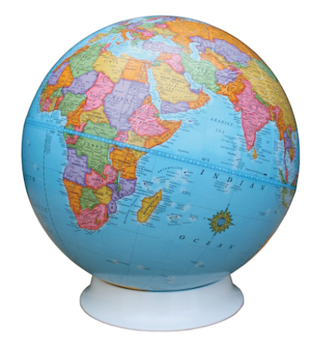
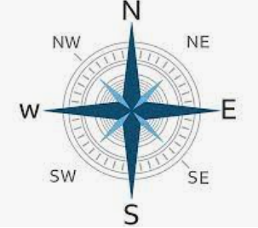
LKS2 Autumn Cycle 1
Geography Knowledge Mat
Concepts: Location, Place, Scale
Subject Specific Vocabulary
Tropics of Cancer and Capricorn | The tropic of Capricorn and the tropic of cancer are both lines that run horizontally along the earth, parallel to the equator. They are used to help measure distance on earth. They are also parallel latitudes indicating global positions. The sun is only directly overhead on the tropics on a solstice.
Latitude | Imaginary Lines that run in an east-west direction across Earth. They are measured in degrees. | Knowledge | Skills
Longitude | Imaginary Lines that run in a north-south direction. They are measured in degrees. | Identify the position and significance of the lines of longitude and latitude. | Use maps, atlases, globes and digital/computer mapping to locate countries and describe features studied
Equator | The Equator is an imaginary line that lies halfway between the North Pole and the South Pole. |  | Use eight points of a compass.
 |  | Locate the Equator, lines of Cancer and Capricorn. Arctic and Antarctic circles .
Northern and Southern Hemispheres | It runs east and west around Earth's middle. Places north of the equator are part of the Northern Hemisphere. Places south of the equator are in the Southern Hemisphere.
 |  | Locate and compare the Northern and Southern Hemispheres.
 |  |  | Use eight points of a compass.
Arctic Antarctic Circles | The area around the North Pole The area around the South Pole
 |  | Identify Prime/ Greenwich Meridian.
Time Zones | A time zone refers to any region where the same standard time is kept
 |  | Understand times zones across the world.

